Slide 1

Hospitality
Analysis
Group-2
Deepali Rajkumar Sudake
Vaitheeswaran R
Mothiga Sri G
Rafeeh k
Battala Sasikala
Rucha Siddharth Pokale
Y Sreeshant

Slide 2
Agenda
Introduction
Business Objective
DataSet Overview & Tools used
KPIS
Dashboards
SQL Queries
Key Insights
Recommendations and Conclusion

Slide 3
Introduction
The hospitality industry runs on tight margins where occupancy, pricing, and customer behavior directly affect profits.
In this project, we analyzed hotel booking data (May–July) to evaluate revenue performance, occupancy efficiency, booking patterns, and revenue loss due to cancellations.
Using Excel, Power BI, and Tableau, we transformed raw data into interactive business dashboards for better decision-making.

Slide 4
Business Objective
The core objective was to answer three business questions:
1.Which properties and cities are driving maximum revenue?
2.Are hotel capacities being utilized efficiently?
3.How much revenue is being lost due to cancellations and no-shows?
The aim was not just visualization, but identifying improvement opportunities.

Slide 5
Dataset Overview & Tools
We worked with 5 datasets including:
Hotel details (city, category)
Room categories
Booking transactions
Aggregated booking capacity data
Date dimension (weekend/weekday analysis)
Excel – Data cleaning & initial KPI calculations
Power BI – Data modeling, DAX measures, dashboard
Tableau – Advanced visual exploration

Slide 6
KPI’s
Total Revenue-1.708M
Total Bookings-135k
Cancellation Rate-24.83%
No Show Count-6759
Occupancy Rate-57.87%

Slide 7
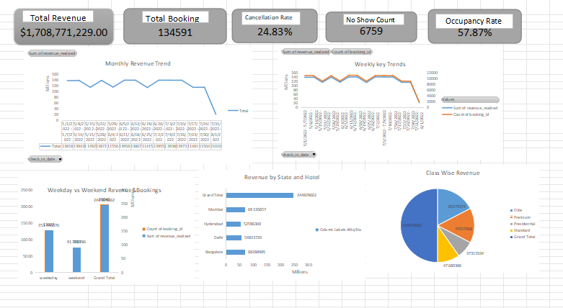
Excel Dashboard

Slide 8
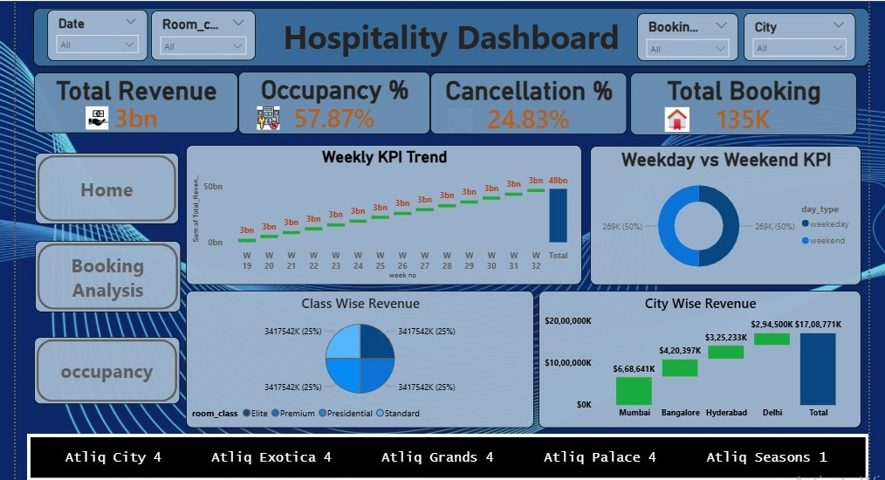
Power Bi Dashboard

Slide 9
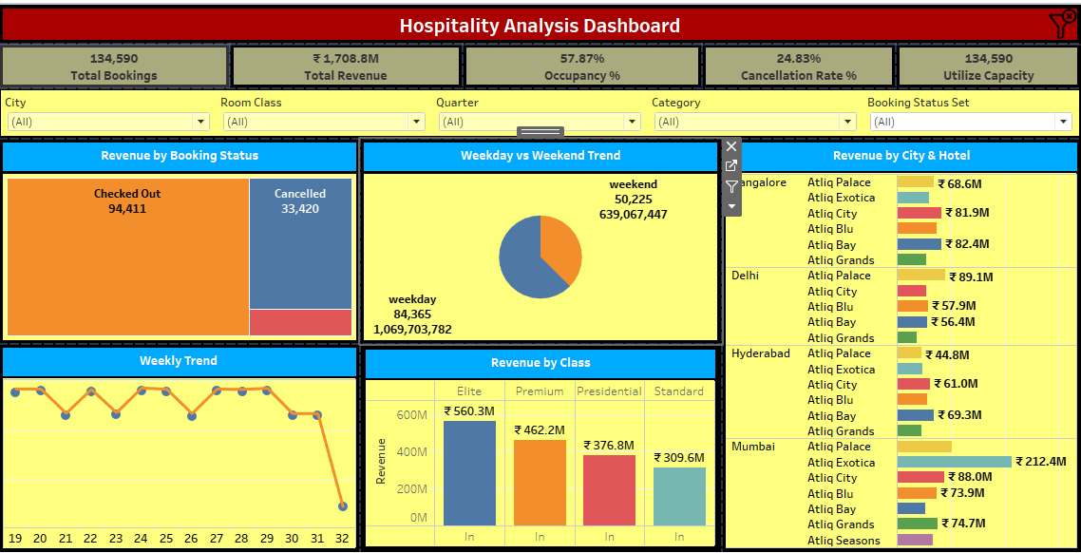
Tableau Dashboard

Slide 10
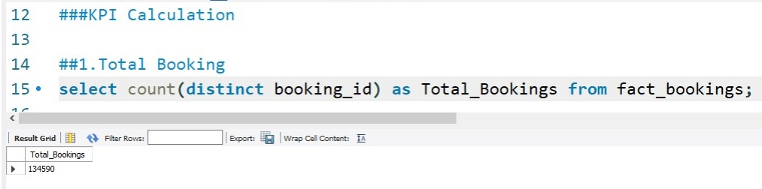
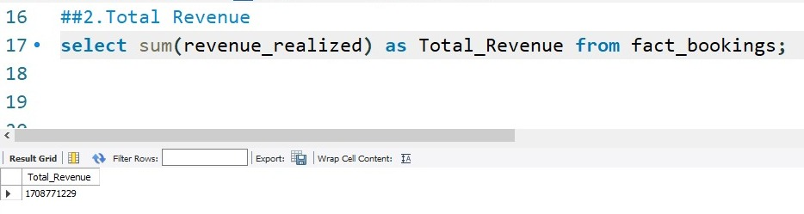
SQL Queries
1.Total Bookings
2.Total Revenue

Slide 11
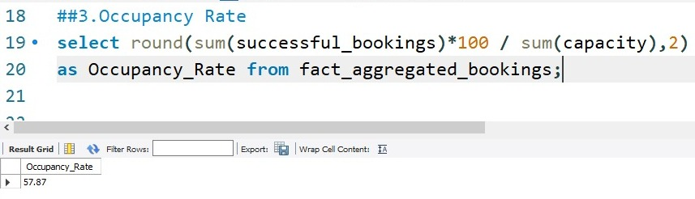
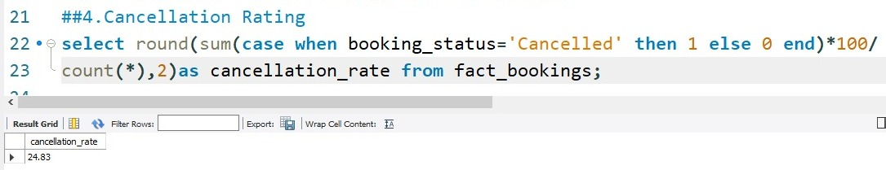
3.Occupancy Rate
4.Cancellation Rate

Slide 12
Key Insights
Luxury hotels earn more revenue but are not always fully occupied.
Weekends have higher occupancy compared to weekdays.
Some hotels have high capacity but low usage.
Cancellations and no-shows reduce actual revenue.
Premium and Presidential rooms earn more per booking but have fewer bookings.
Most bookings come from online platforms.

Slide 13
Recommendations
Apply dynamic pricing on weekends to maximize revenue.
Offer weekday discounts to balance occupancy.
Implement stricter cancellation / advance payment policies.
Promote low-performing properties with targeted marketing.
Improve ratings to boost repeat bookings.

Slide 14
Conclusion
This project shows how data analytics converts hotel booking data into actionable insights. By analyzing revenue, occupancy, and cancellations, we identified key gaps and improvement areas. The dashboard supports smarter decisions to optimize revenue, occupancy, and overall efficiency.

